Slide 1
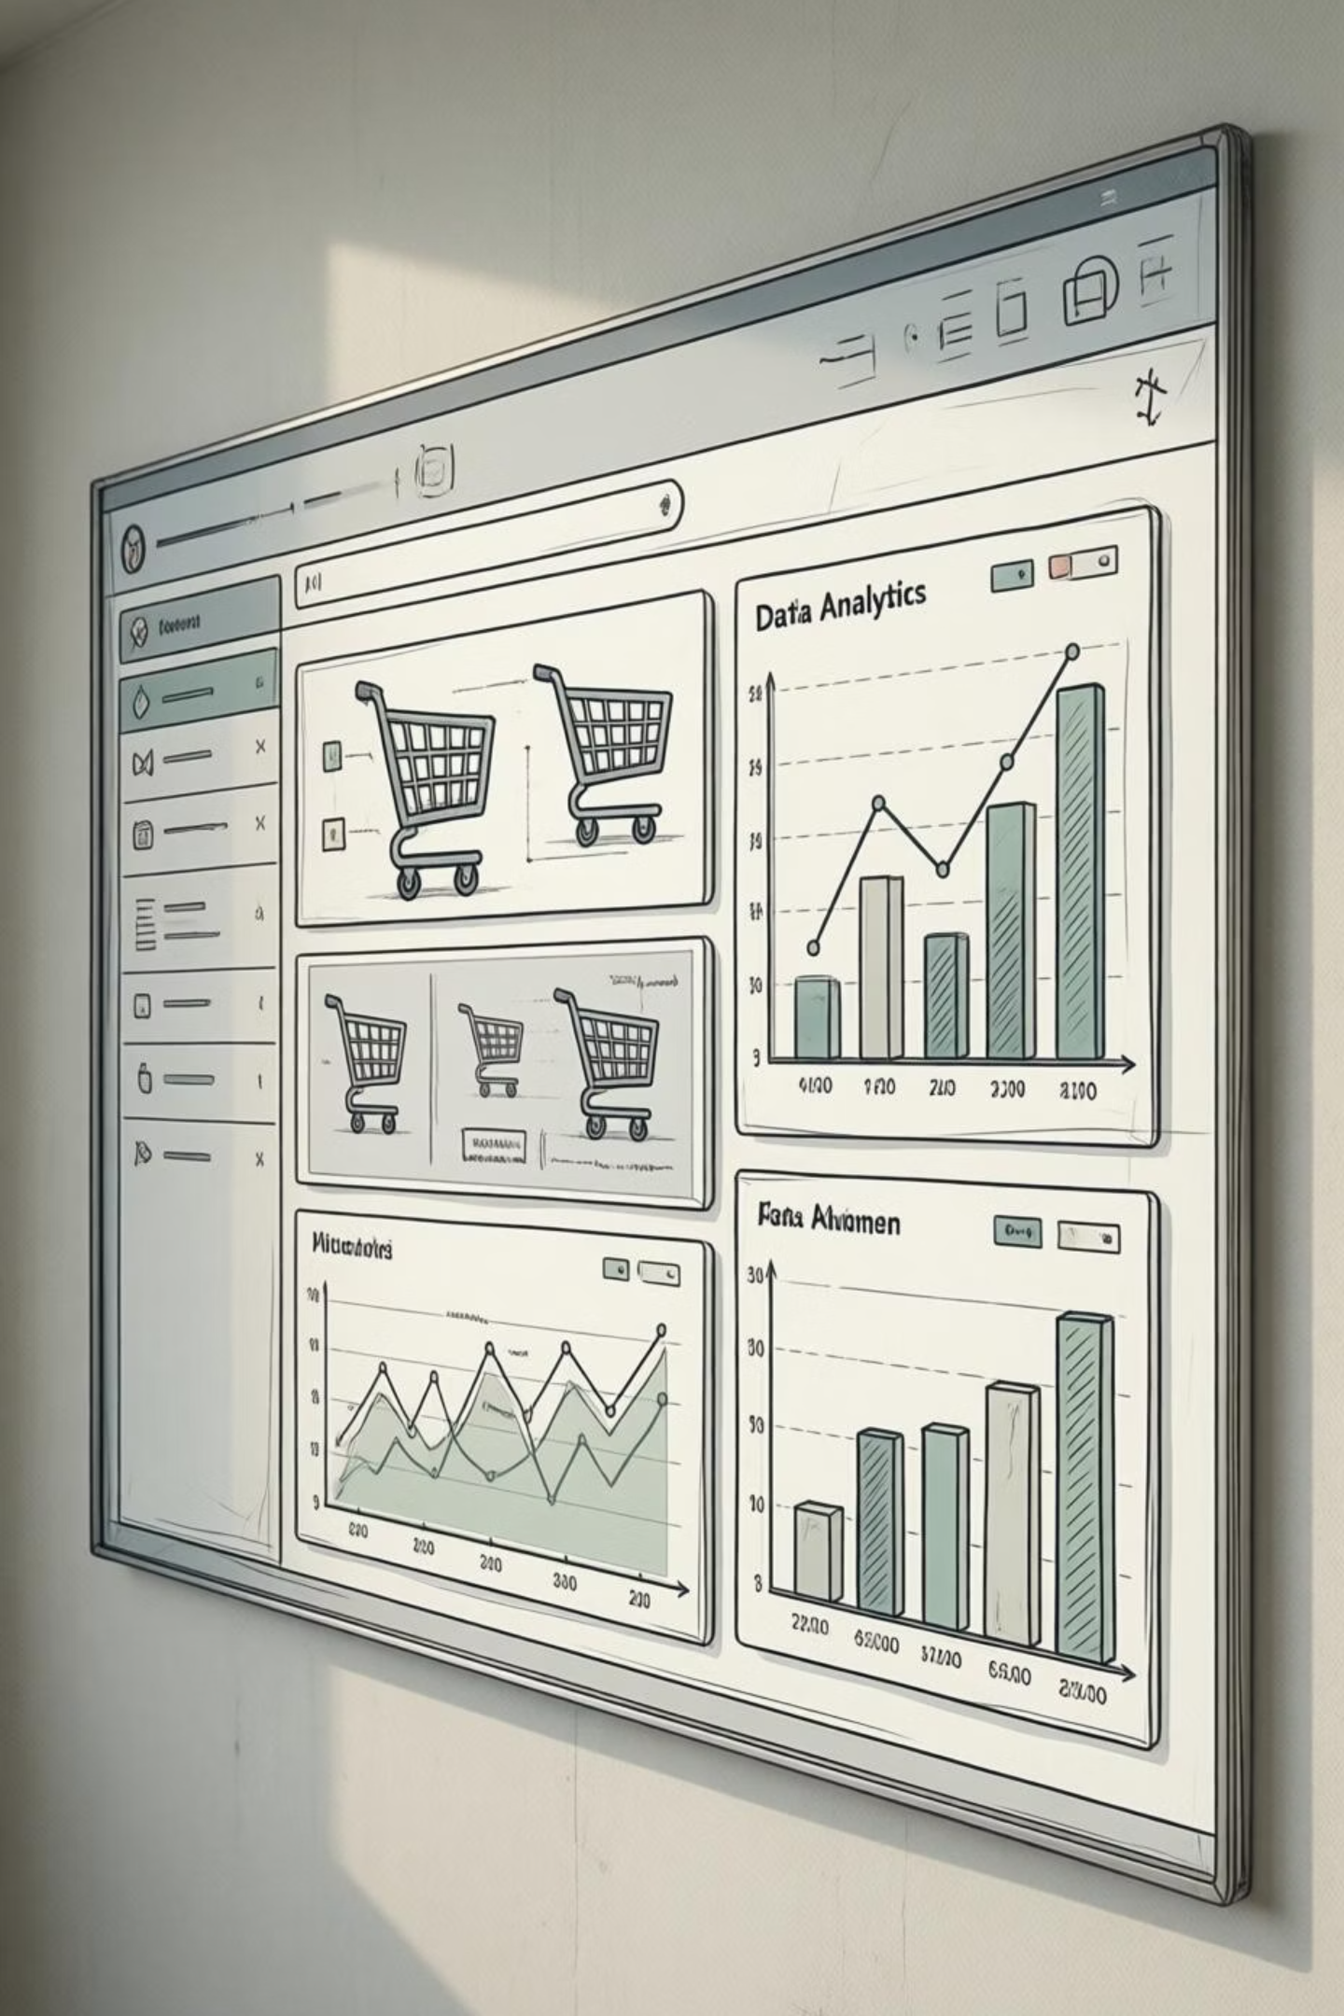
Customer Shopping Behavior Analysis
Uncovering insights from 3,900 purchases to guide strategic business decisions

Slide 2

DATASET OVERVIEW
The Foundation
Scale
18
37
3,900 customer transactions analyzed across multiple product categories
Data Points
Missing Values
Key features tracked per transaction
Only in Review Rating column

Slide 3

Data Preparation Journey
01
Data Loading
Imported dataset using pandas for initial exploration
02
Missing Data Handling
Imputed Review Rating nulls using median by category
03
Feature Engineering
Created age groups and purchase frequency metrics
04
Database Integration
Loaded cleaned data into PostgreSQL for analysis

Slide 4
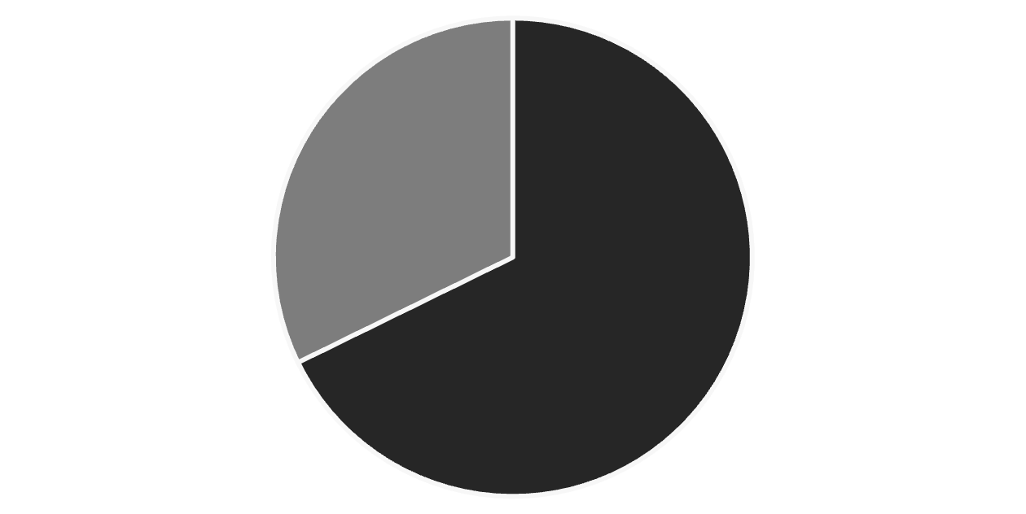
Revenue Insights
Gender Revenue Split
Male customers generate 68% of total revenue, significantly outpacing female customers at 32%.
This insight suggests targeted marketing opportunities for both segments.
Male
Female

Slide 5

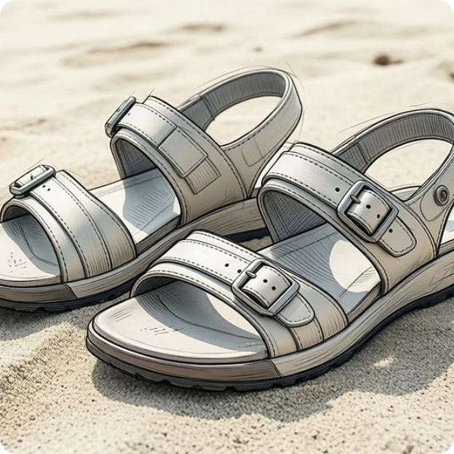

Product Performance
Gloves
Sandals
Boots
Top-rated at 3.86 stars
Second highest at 3.84 stars
Strong rating of 3.82 stars

Slide 6

Customer Segmentation
Returning — 701
New — 83
Loyal — 3,116
Loyal customers dominate at 80% of the customer base, indicating strong retention success.

Slide 7


Subscription Analysis
Key Finding
Average spend nearly identical: $59.49 (subscribers) vs $59.87 (non-subscribers)
Massive opportunity: 958 repeat buyers (5+ purchases) haven't subscribed yet
27%
Subscribers
1,053 customers with subscriptions
73%
Non-Subscribers
2,847 customers without subscriptions

Slide 8
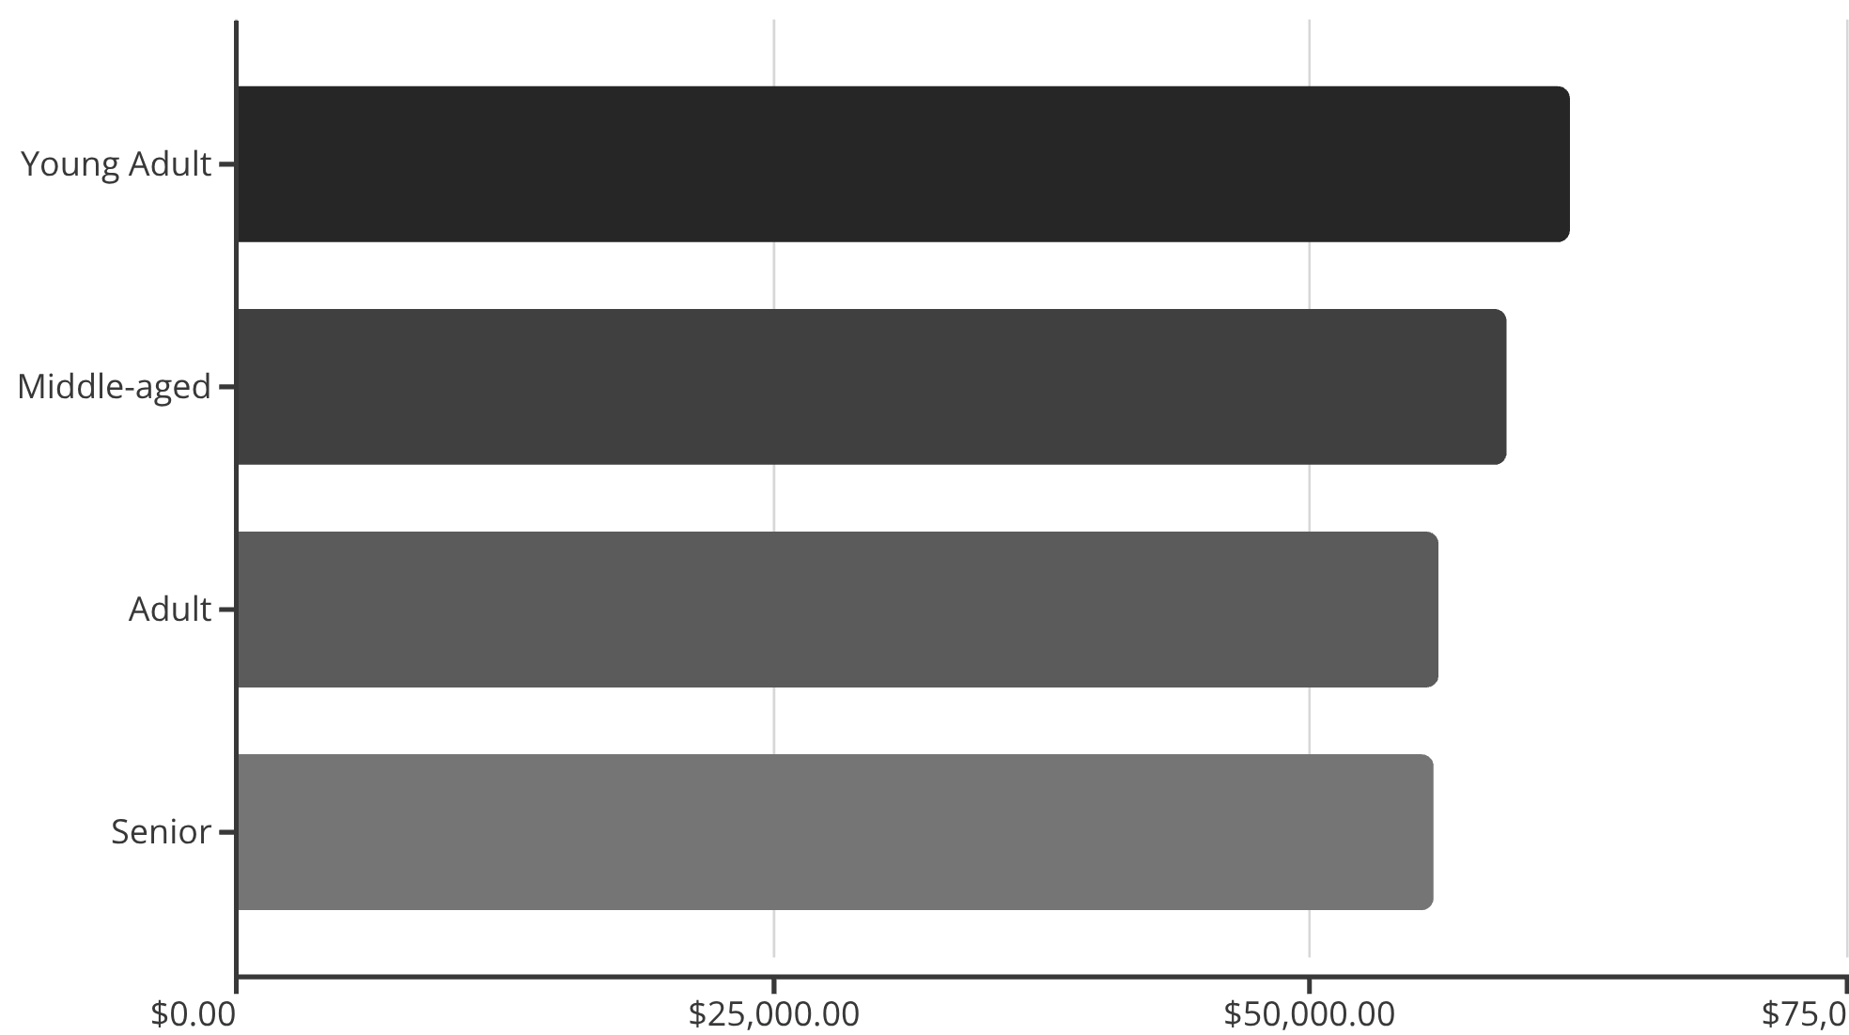
Revenue by Age Group
Balanced Distribution
Young adults lead slightly, but all age groups contribute nearly equally to revenue.

Slide 9

Power BI Dashboard
3.9K
$59.76
3.75
Total Customers
Avg Purchase
Avg Rating
Interactive dashboard visualizes customer behavior, revenue patterns, and sales distribution across categories and demographics.

Slide 10
ACTION PLAN
Strategic Recommendations
Boost Subscriptions
Loyalty Programs
Review Discount Policy
Target 958 repeat buyers without subscriptions with exclusive benefits
Reward repeat buyers to accelerate movement into loyal segment
839 high-spending discount users show opportunity to balance promotions with margins
Product Positioning
Targeted Marketing
Highlight top-rated items (Gloves, Sandals, Boots) in marketing campaigns
Focus on young adults and express shipping users for maximum revenue impact

